Slide 1
Simple Siamese Representation Learning:
A Self-Supervised Learning Method
(SimSiam)

Slide 2
What is SimSiam?

Slide 3

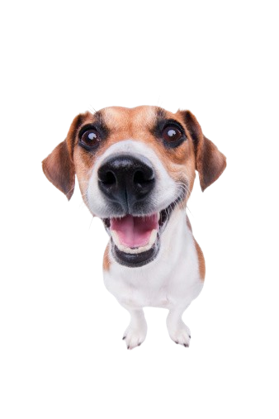


Oh! You know me SimSiam
Doggesh
+

Slide 4
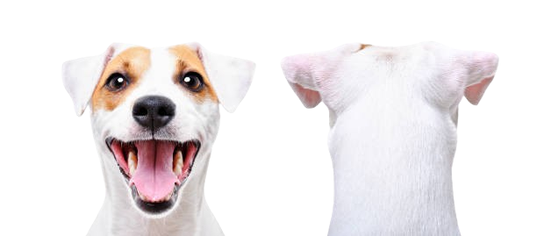
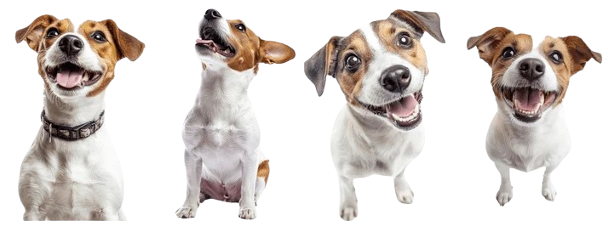

Slide 5
OBJECTIVE
The objective of SimSiam is to make the two augmented views of the same image produce similar representations (feature vectors).
Doggesh Says
“No matter how you make me smile, look sad, or see my teeth.
My inner identity doesn’t change.”
“SimSiam does the same thing for images: even when brightness, color, or angle changes, it learns that it’s still the same object.”

Slide 6
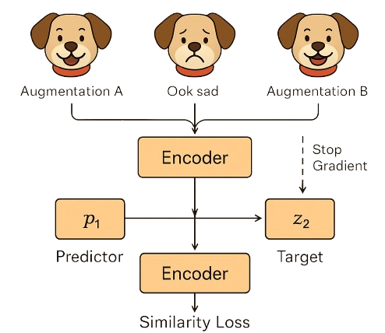

Slide 7




HOW IT WORKS?
Positive Pairs
Negative Pairs
Learning Target
Stop Gradient

Slide 8
WHY IT FIT OUR DATASET?
Dataset Type Agricultural leaf images (Betel leaf – Piper betle)
Total Images 1,800 high-resolution images (1080×1080 px)
Classes Healthy (669), Diseased (509), Dried (622)
Environments Collected from both Field and Controlled conditions
Variation Large variation in lighting, color tone, texture, and background
Challenges Limited sample size, visual noise, and similar-looking leaf categories

Slide 9
WHY IT FIT OUR DATASET?
Small dataset - (Only 1,800 images) SimSiam works great on small data without negatives.
Visual variation - (Learns invariance) meaning it recognizes the same leaf even when brightness or angle changes.
Texture & Color focus - Helps model learn fine texture details of healthy vs diseased vs dried leaves.
Lightweight & stable simple structure - Lightweight, no teacher network, and easy to train even on a T4 GPU.
Citations
Chen, X., & He, K. (2020). Exploring Simple Siamese Representation Learning. arXiv:2011.10566.
Mane, G., Bhise, R., Kadam, R., et al. (2025). PriBeL: A Primary Betel Leaf Dataset from Field and Controlled Environment. Data in Brief, 61, 111674. https://doi.org/10.1016/j.dib.2025.111674

Slide 10
Thank you

